Slide 1
CNN for NLP
YBIGTA 14기 이명진

Slide 3
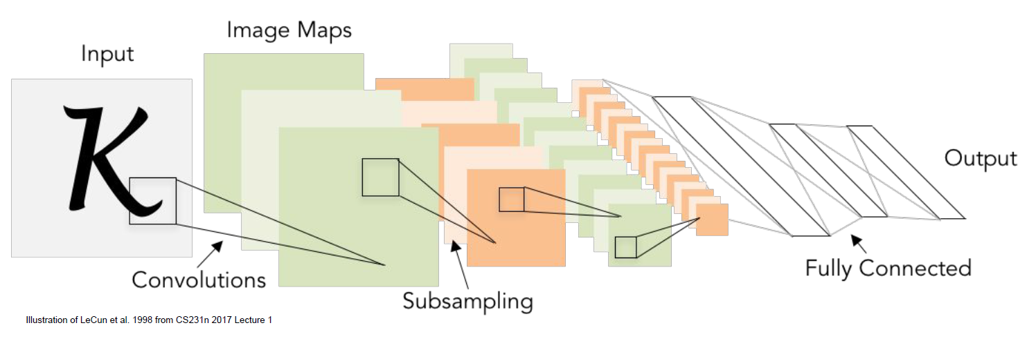

Slide 4
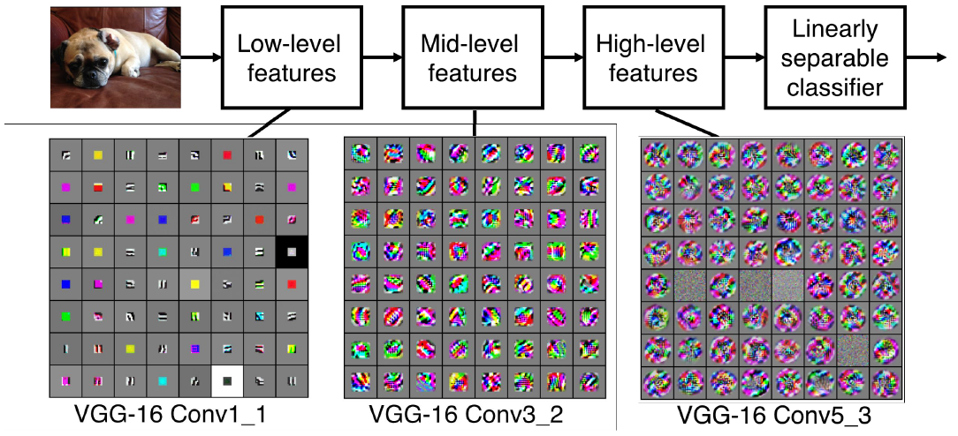

Slide 5
Main Idea
What if we compute vectors for every possible word subsequence of a certain length?
Example: “tentative deal reached to keep government open” computes vectors for:
tentative deal reached, deal reached to, reached to keep, to keep government, keep government open
Regardless of whether phrase is grammatical
Not very linguistically or cognitively plausible
Then group them afterward

Slide 6
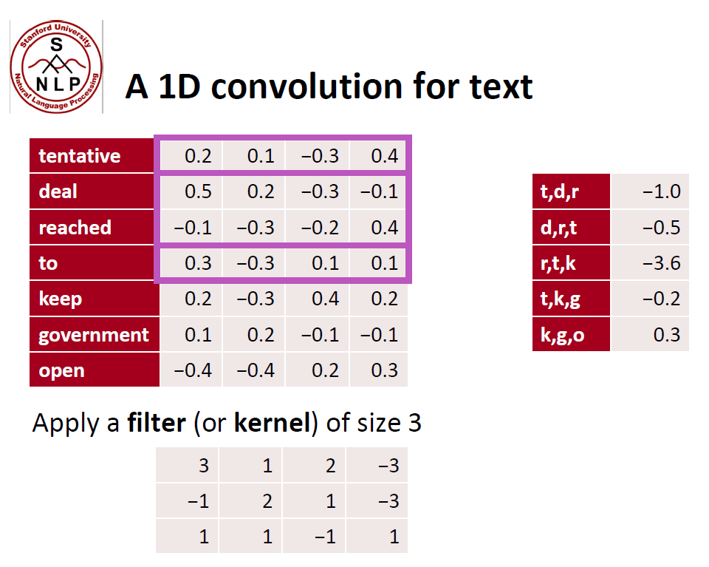

Slide 7
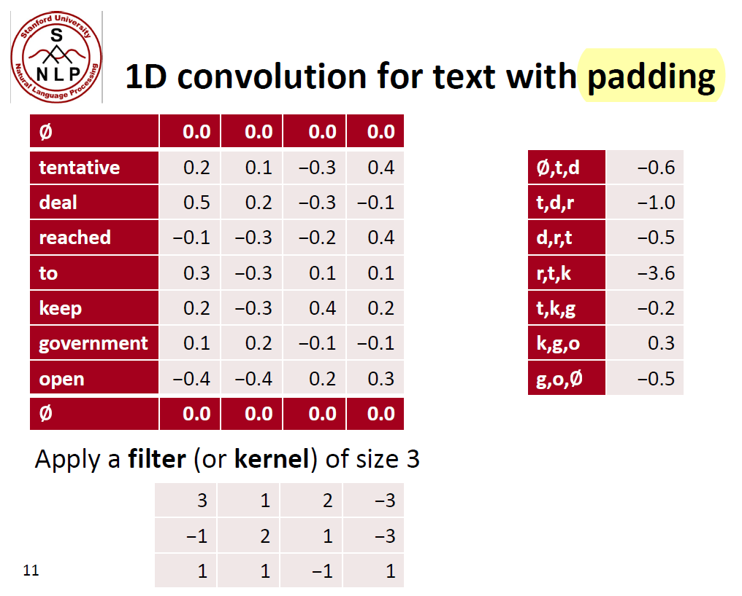

Slide 8
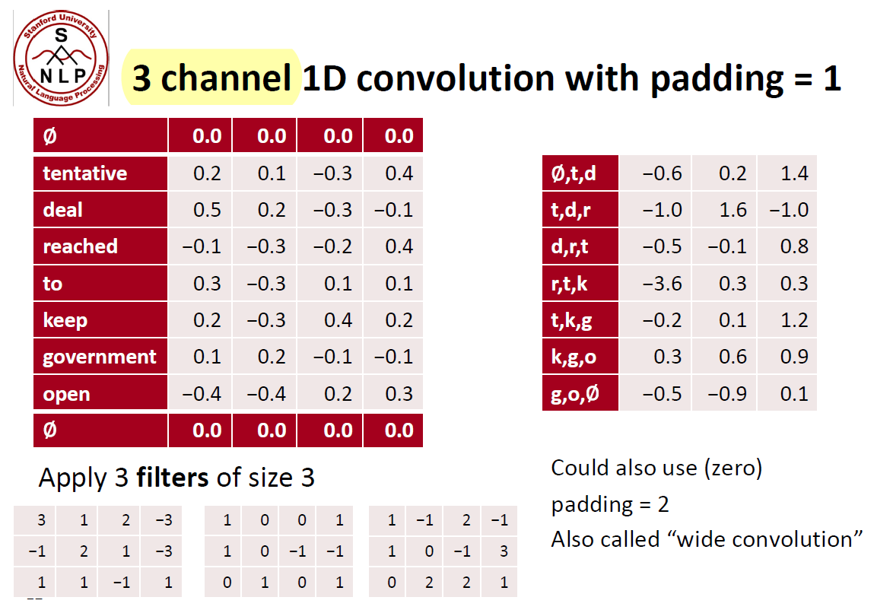

Slide 9
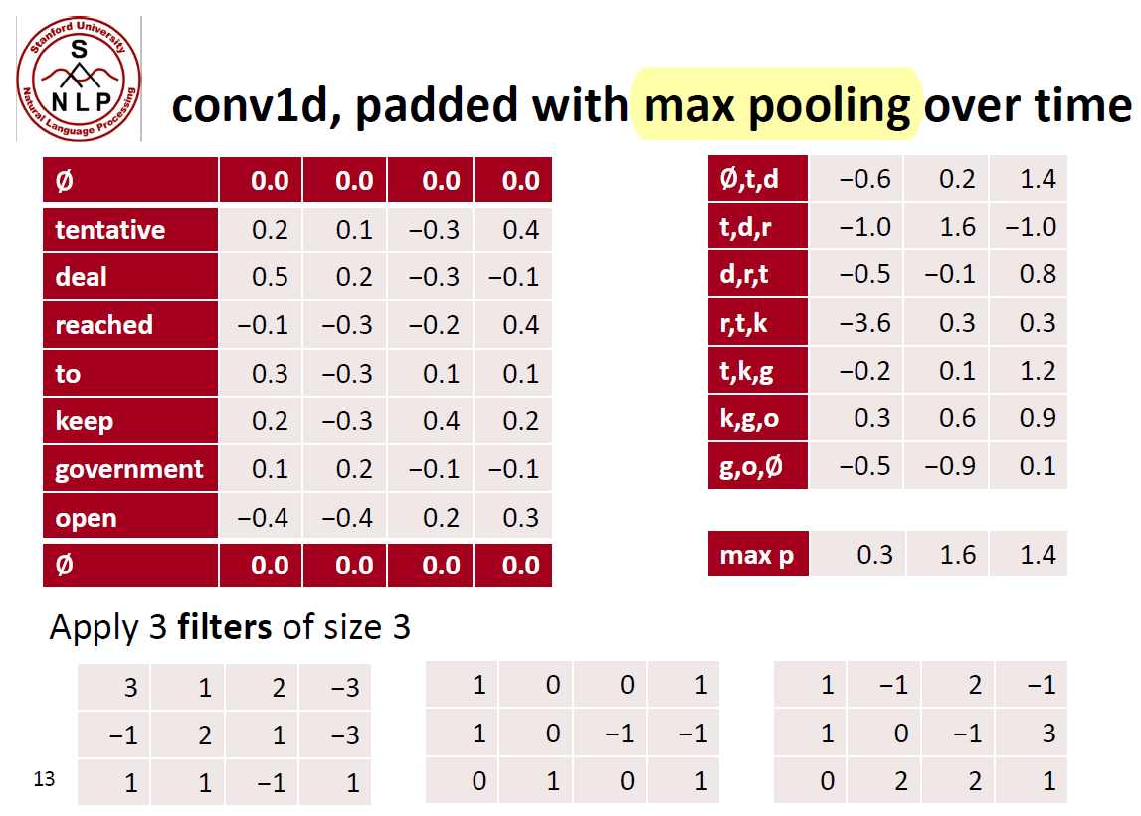

Slide 10
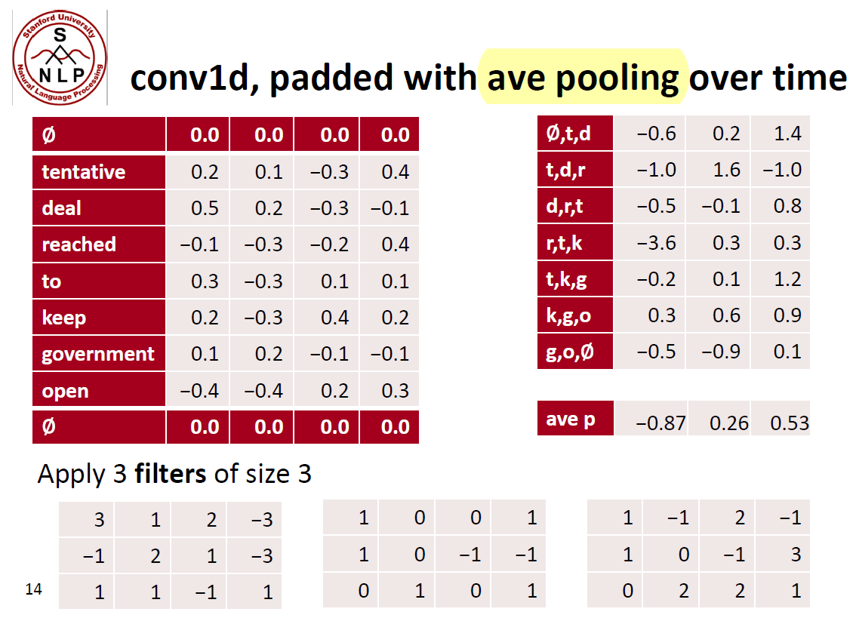

Slide 11
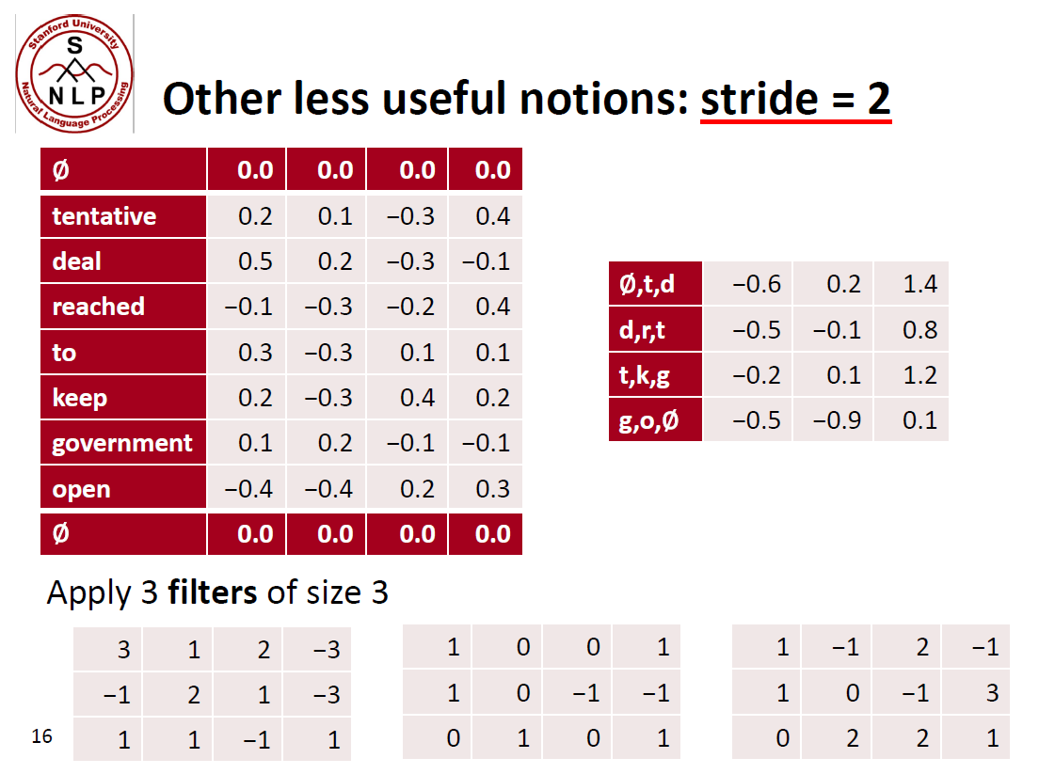

Slide 12
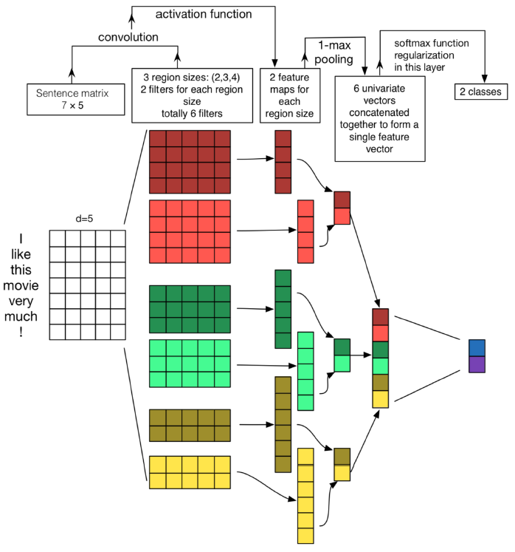
Convolutional Neural Networks for Sentence
Classification. (Kim, 2014)
A simple use of one convolutional layer and pooling
Filter could be of size 2, 3, or 4
Initialize with pre-trained word vectors (word2vec or Glove)

Slide 13
